Slide 1


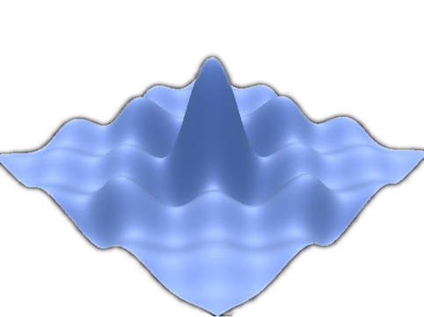

Telerik Test Studio
Web Testing
Pavel Pankov
QA Lead
Automated Testing Team
Telerik QA Academy

Slide 2

Table of Contents
Introduction to Telerik Test Studio
Working With Projects
Recording Tests
Verification
Extractions
Logical Steps
Test Organization
Working With Test Results
Web Application Tests
Data Driven Tests

Slide 3
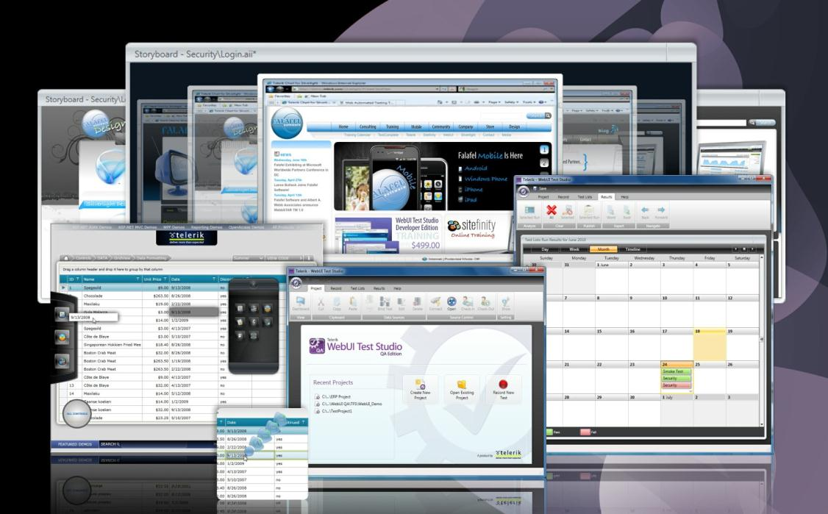
Introduction to Telerik Test Studio

Slide 4
Telerik Test Studio
Telerik Test Studio is an automated testing tool
Offers an intuitive, codeless and productive way to test any web or WPF desktop application
Test recording is performed extremely easy
In the same manner as an end user would accomplish these same tasks
Web test recording is performed directly in the browser

Slide 5

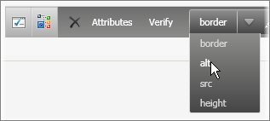
Telerik Test Studio (2)
Navigation, text entry, clicking links, drag-and-drop, hovering the mouse are all recorded as test steps
Smart point-and-click wizards visually highlight elements and automatically generate "verifications" as test steps

Slide 6
Test Studio Versions
Test Studio offers two versions:
Standalone version
For QA professionals
Formerly known as 'QA Edition'
Visual Studio plugin
For developers willing to perform functional testing themselves
Formerly 'Developer Edition' now known as 'Test Studio Express'

Slide 7

Test Studio Features
Test Studio features:
Rich highlighting surface
DOM Explorer for HTML & Silverlight (Visual tree)
Element menu for rich on the spot recordings
Quick tasks for dynamic verifications
Data Driven Testing
Silverlight support
Ajax Support

Slide 8
Test Studio Features (2)
Test Studio features:
Automatic Synchronization steps
Command line execution support
Build server integration (CruiseControl, TeamBuildServer)
Results management using a results calendar
Test list management that supports ordering

Slide 9
Test Studio Tabs and Panes Tour
Quick Demo

Slide 10
Working With Projects

Slide 11
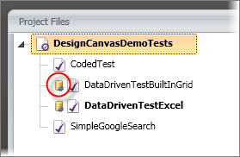
Project Files Pane
The Project Files Pane uses visual cues to indicate the current status of projects, folders and tests
Tests that are data bound display the database icon as shown in the screenshot below

Slide 12
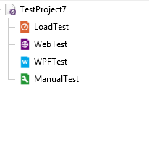
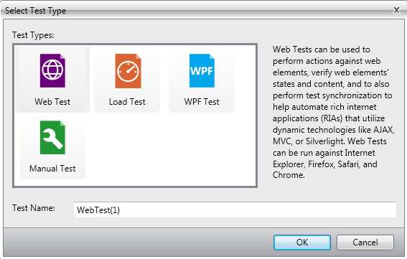
Web vs. WPF Tests
Test Studio provides convenient organization of Web, WPF, and Manual tests in a single grid

Slide 13

Team Foundation Server Integration
Test Studio can be integrated to Team Foundation Server (TFS) (source control system)

Slide 14
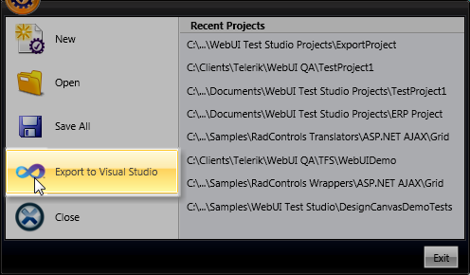
Exporting Projects to Visual Studio
Test Studio projects can be exported in a form that can be consumed by developers using Visual Studio
The Export to Visual Studio Ribbon Bar menu item creates a Visual Studio 2008,2010 or 2012 project
Available even without TFS

Slide 15
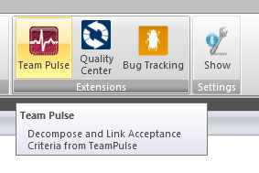

TeamPulse Integration
Test Studio provides
Enables linking between user stories and acceptance test criteria in TeamPulse to functional tests within Telerik Test Studio

Slide 16

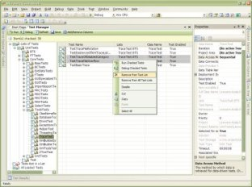
MS Test Manager Integration
Test Studio provides integration with MS Test Manager
Supporting continuous integration

Slide 17
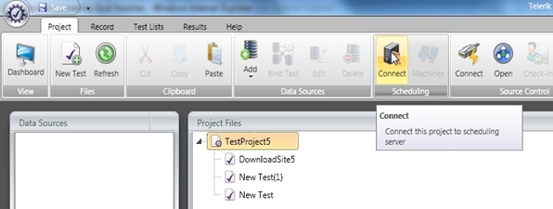
Scheduling
Test Studio allows users to quickly schedule test lists
Executed across all available workstations
Completely independently of any external tools

Slide 18
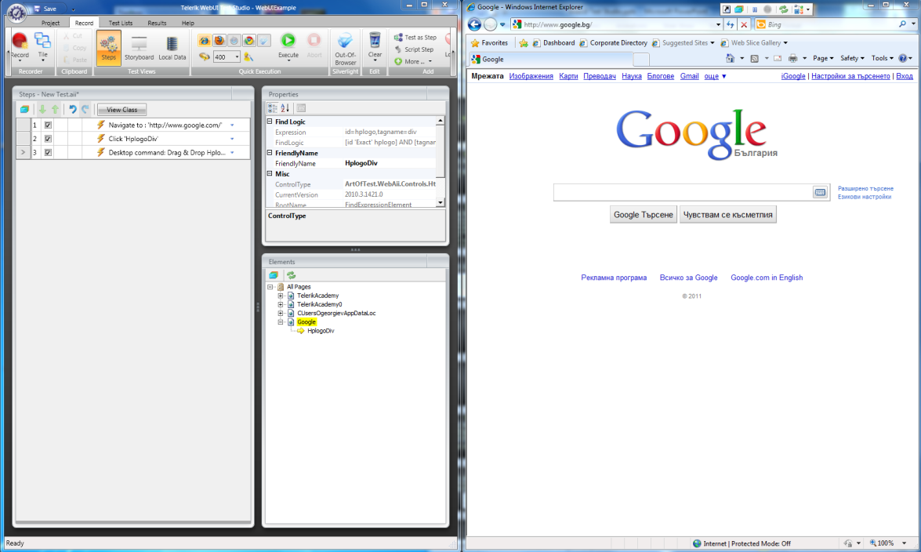
Recording Web Tests
Using the Recording Surface Browser

Slide 19
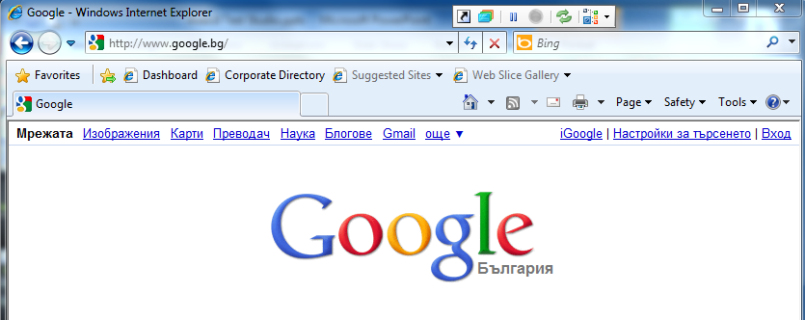
Recording Surface Browser
The Recording Surface Browser provides the ability to record all your actions against a web page
Allows identifying specific elements in the page and handling many common dialogs that might pop up

Slide 20

Recording Surface Toolbar
The Recording Surface toolbar controls your interaction with the browser page
Provides the following options:
Back to Host
Enable Highlighting
Pause Recording
Record
Refresh Recorder
Show DOM Explorer

Slide 21
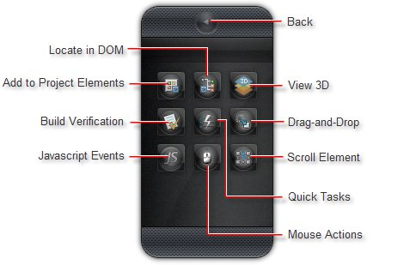
Elements Menu
The Elements Menu provides quick access to relevant functions right in the page you are testing

Slide 22

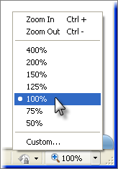
Browser Resolution
Browser Resolution
If the highlight appears offset from the element it should be surrounding, make sure that your browser zoom level is set to 100%
In the screenshot below, the zoom level is 90%

Slide 23
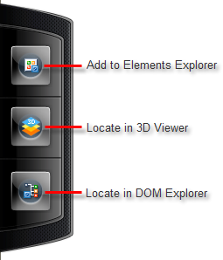
Common Tasks Menu
The Common Tasks Menu allows you to associate an element in the Recording Surface to a common task
You can add the element to the Elements Explorer, the 3D Viewer or the DOM Explorer

Slide 24
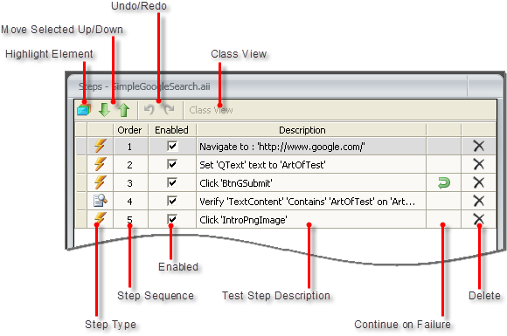
Test Steps
The Steps Pane allows working with individual steps in the test, the step's elements and any code for the test

Slide 25
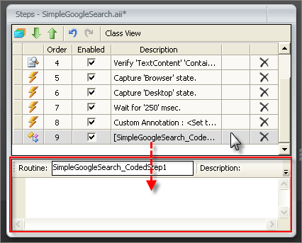
Adding Test Steps Manually
There are some steps that have to be added specifically
Test as Step lets you run another test as a single step
Script Step adds a coded step to the test and opens the code editor

Slide 26
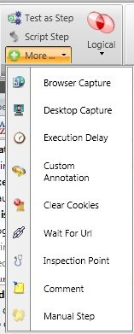
Additional Steps Options
The More... button provides additional steps to add to your test:
Browser Capture,
Desktop Capture
Execution Delay
Custom Annotations
Clear Cookies
Wait for Url
Inspection Point
Comment
Manual Step

Slide 27

Translators
Translators are extensions that open up an element to work with Test Studio
The translator describes the actions of an element that can be automated and verifications that can be performed
Test Studio ships with basic translators for HTML and Silverlight, and translators built specifically for AJAX and Silverlight RadControls

Slide 28
Drag and Drop
Drag and drop of any element in a web page can be automated
I.e. simple HTML elements, RadControls for ASP.NET AJAX and Silverlight elements
There are two ways to automate a drag and drop operation
Dragging elements directly with the mouse in the Recording Surface
Using the Elements Menu Drag and Drop option

Slide 29
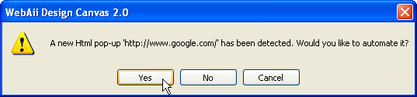
HTML Popups
HTML popups are detected by Test Studio automatically
When an HTML popup is about to appear, Test Studio allows you to automate the popup

Slide 30
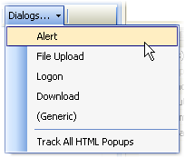
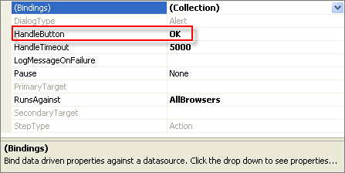
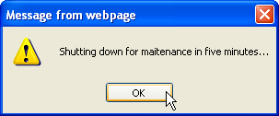
Win32 Dialogs
You can respond to a number of common Win32 dialogs using the Recording Surface "Dialogs" drop down list

Slide 31
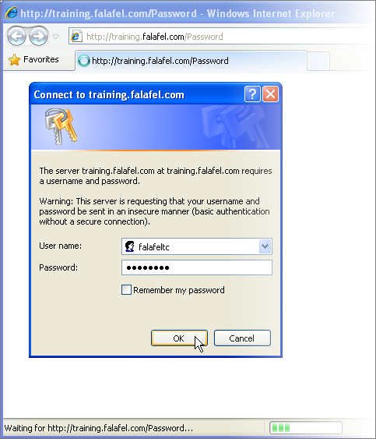
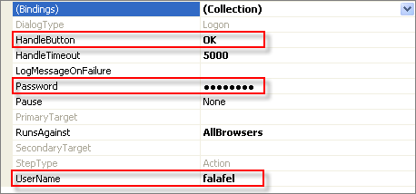
Logon
Some web pages may require a user name and password to gain access
The logon handler fills in the user name and password and then clicks the OK or Cancel button to close the dialog

Slide 32


Verification
Verifying Elements' State

Slide 33
Verifications
Test Studio verifications allow detecting if elements are in a particular state (e.g. visible, exist)
Also that attributes and properties compare with specific values
Test Studio can verify:
Content, attributes, styles, visibility, drop-down list selections, checkboxes, radio buttons, tables and Silverlight property values

Slide 34
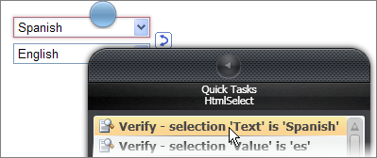
Verification Sentences
Test Studio implements verification through "sentences" that compare a portion of an element to a value
E.g., "textbox content is equal to 'order 8599'"
"image path contains 'http://www.falafel.com'"

Slide 35
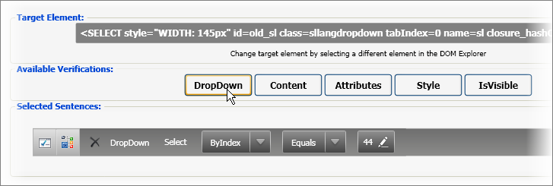
Sentence Verification Builder
The Sentence Verification Builder
Allows interactive building of verification rules and validating them against a live web document

Slide 36
Sentence Structure
The structure of the "sentence" changes according to verification type
Here are the general structures for some of the basic verification types used against HTML elements
Verification Type | Structure
Content | Content Type-Compare-Value
Attribute | Attribute Name-Compare-Value
IsVisible | Value
Style | Inline/Computed-Category-Attribute-Compare-Value
DropDown | Attribute Name-Compare-Value

Slide 37
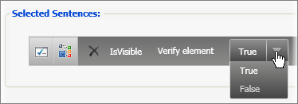
Verification Types
IsVisible
Test Studio determines visibility by following the CSS chain
Analyzing "visibility" and "display" attributes for an element

Slide 38
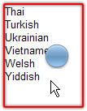
Verification Types (2)
Content verification
Test some portion of element content against a string of characters
Content type
Comparison
Value

Slide 39
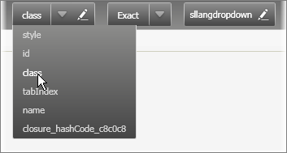
Verification Types (3)
Attribute verification
Allows high flexibility against any attribute in an element
The attribute name drop down lists all the attributes in the element
When an attribute is selected, the Value will automatically populate with appropriate matching text

Slide 40
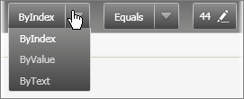
Verification Types (4)
Style verification
Has a relatively complex sentence structure
DropDown verification
The DropDown verification has built-in attribute types "ByIndex", "ByValue" and "ByText"

Slide 41
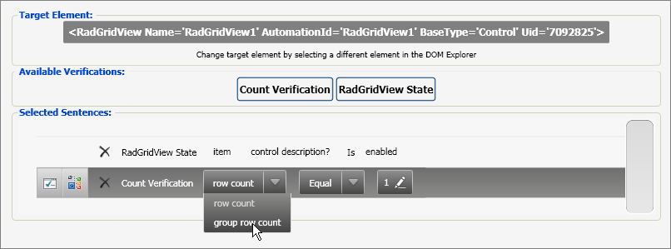
AJAX and Silverlight (5)
Test Studio provide easy testing for AJAX and Silverlight by way of the consistent Sentence Verification Builder interface
Instead of looking at the HTML DOM, we're able to test against Silverlight elements in a XAML (Extended Application Markup Language) document

Slide 42
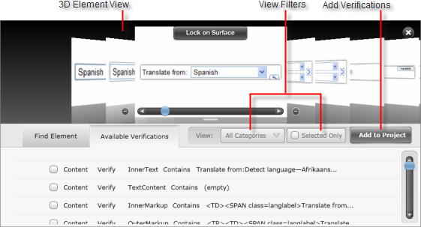
3D Viewer
3D Viewer
The 3D Viewer is an innovation that saves time by handling verifications for multiple elements all at one time

Slide 43
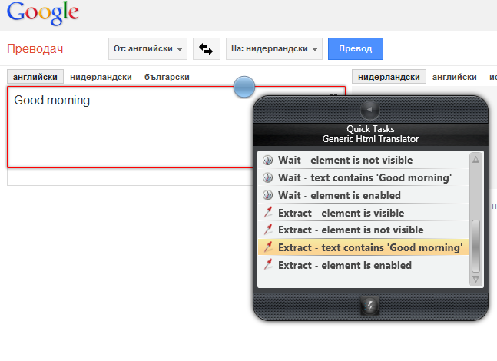
Extraction
Extractions can be added in order to be reused later in the tests
Available form the "Quick Task“ menu

Slide 44
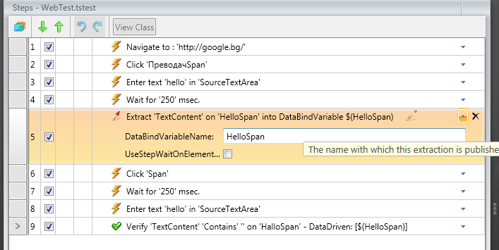
Extraction
Extracted parameter is stored in a variable
We can name our stored variable
We can refer to the variable by its name
Name used to refer to the variable
Name we give to the variable
Referring to the stored variable

Slide 45
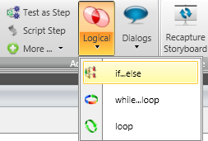
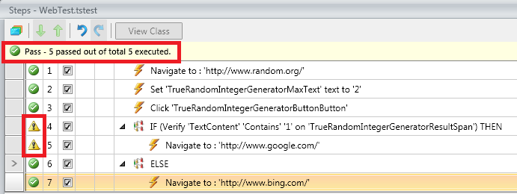
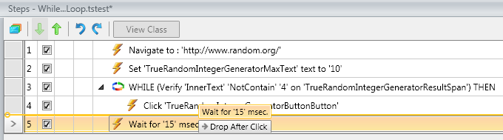
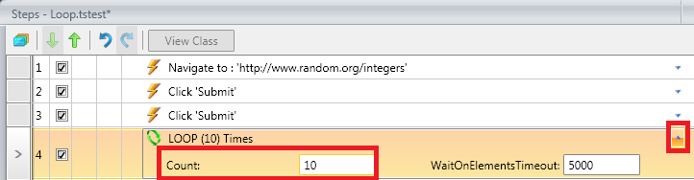
Logical Steps
The flow control in Test Studio can be implemented through logical steps
If…else
While…loop
loop

Slide 46
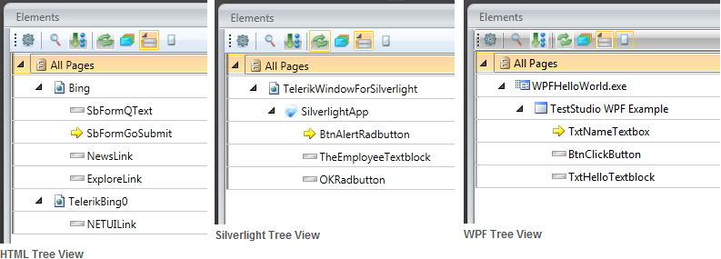
Elements Explorer
The Elements Explorer is similar to the DOM Explorer
it displays a tree of elements
Elements may be used in several tests and test steps

Slide 47
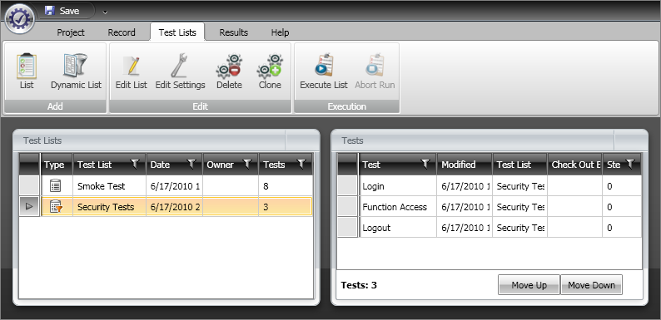
Test Organization
Using Test Lists

Slide 48
Test Lists
Test Lists
Useful for getting the best use of recorded tests by allowing the reuse of tests in more than one configuration
E.g., using a small selection of tests as a "Smoke Test"
Collecting tests that a particular QA engineer is responsible for
Listing all the tests for a category of functionality

Slide 49

Static Lists
Static lists
Can be manually built from existing tests and manually set the order that the tests should run
When the Test List executes, each test runs in order, exactly as configured

Slide 50
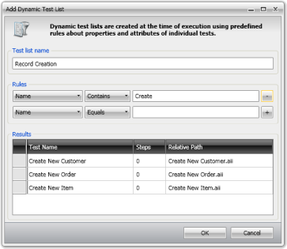
Dynamic Lists
Dynamic Test Lists automatically select tests from your project at the time of execution
Using rules about properties of the individual tests
Warning – Dynamic Test Lists cannot be ordered
Therefore only independent tests should be grouped dynamically

Slide 51
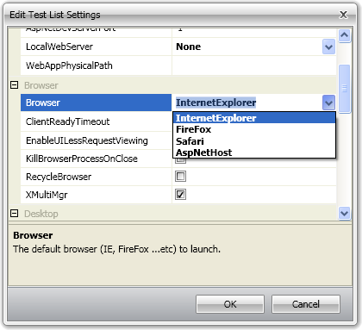
Editing Test List Settings
Test Studio allows editing the following properties:
Annotation
ASP.NET
Browser
Desktop
Execution
HttpProxy
Log
Navigation
Silverlight

Slide 52
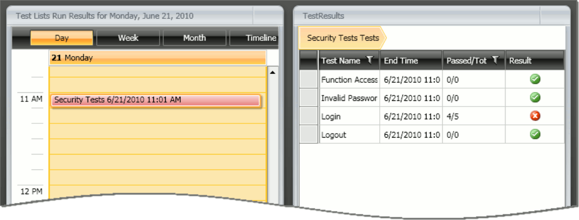
Working With Test Results
Analyzing and Sharing Test Results

Slide 53
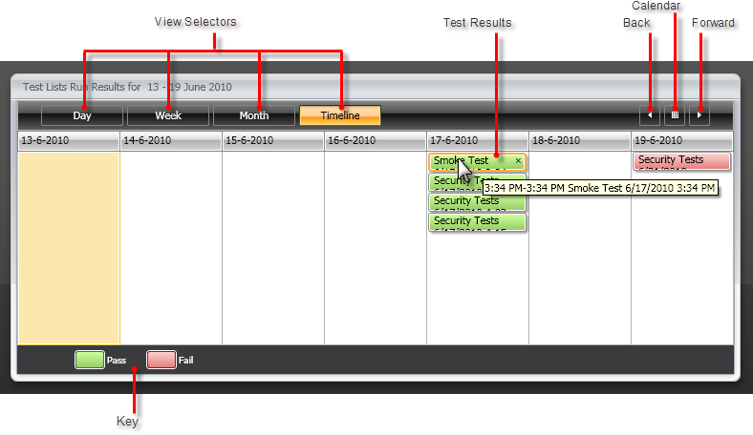
Test Results Calendar
The calendar view of test results makes it easy to see the tests that passed or failed in a month, week or day

Slide 54
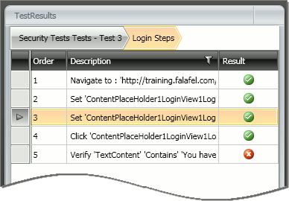
Analyzing Test Results
The TestResults panel allows traversing test execution results, drilling down to the individual test step and back up again to the test list level

Slide 55
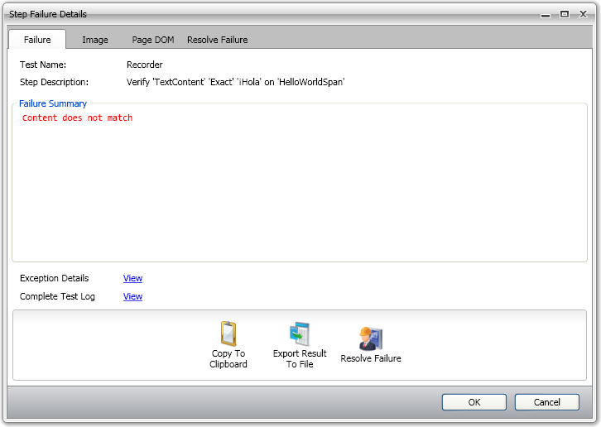
Step Failure Details Dialog
The Step Failure Details dialog collects all the information related to a single failed test step, including failure details, screenshots, and a snapshot of the DOM

Slide 56
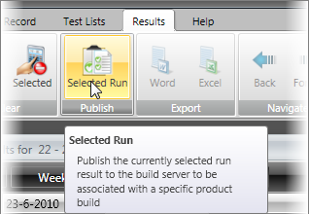
Exporting Test Results
Test results become truly useful when they are pushed out to the members of your organization
The Export tools allow you to create Word or Excel versions of the entire Test List
With TFS a selected run result can be made accessible to others by pushing out the results to TFS

Slide 57



Web Application Tests
Handling Issues of Web Testing

Slide 58
Web Application Tests
Testing a web application is quite a bit more difficult than testing the same functionality in a Windows Desktop application
Specific issues are encountered:
Timing difficulties
Differences between browsers
New technologies make web browsing a rich, but difficult-to-test, experience

Slide 59
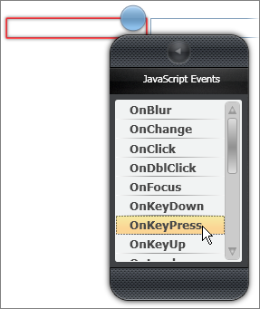
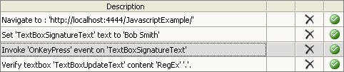
JavaScript
Test Studio can trigger specific JavaScript events as test steps
Use the Elements Menu, JavaScript Events button to invoke and choose from available events

Slide 60
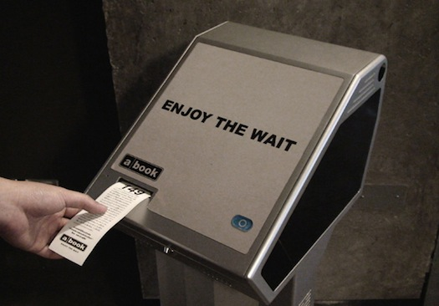
AJAX
One of the principal ways AJAX can be handled in Test Studio is by waiting for a particular element to reach some state
E.g. "text content = '1234'"

Slide 61

Setting "Wait" Steps
Test Studio allows changing any verification step to a "wait" step
A wait step can be added from the Elements Menu Quick Tasks
Another way is by right-clicking the verification test step and selecting Set as Wait from the context menu

Slide 62
Setting "Wait" Steps (2)
The verification step, when acting as a wait, has a few properties:
CheckInterval
The number of milliseconds between evaluations of the verification
Timeout
The number of milliseconds before the test step will fail when used as a wait

Slide 63
Setting "Wait" Steps (3)
The verification step, when acting as a wait, has a few properties:
WaitOnElements
indicates that the test step should wait WaitOnElementsTimeout milliseconds for step elements to exist before executing the test step
SupportsWait, IsWaitOnly and StepType
Read-only properties that indicate the way this test step can be used

Slide 64

RadControls for ASP.NET AJAX
Testing RadControls for ASP.NET AJAX is s bit different from any other control
Due to the translators provided by Telerik
Test Studio provides set of verifications and Quick Tasks for RadControls

Slide 65

Silverlight
Test Studio is the first scriptless record and playback solution for Silverlight
With Test Studio you can build a single test case that interacts with both HTML and Silverlight elements, even on the same page

Slide 66
Silverlight
How Does Test Studio address Silverlight testing Issues?
Identification
Identifying and locating elements by criteria or combination of criteria other than name – e.g., text, partial text or element type
Synchronization
Even animated elements can be waited and checked
Reveal Control Internals

Slide 67


Data Driven Tests
Driving Your Tests Using Data Sources

Slide 68

The Built-In Grid
The built-in grid allows you to build simple, ad-hoc, data-driven tests
This functionality is very simple
It is not expected to connect to an external database
Has multiple tables or provide fine tune control over looping or branching

Slide 69
Connecting to External Data
Test Studio allows connecting to a variety of data types
Standard "*.csv" comma delimited files, Excel "*.xls" files , XML files and database tables
The main steps to drive a test with data are:
Add a data source
Bind the data source to a test as a whole
Bind a specific piece or column of data to a property in the test

Slide 70


Data Driven Tests
Demo
Using the built-in grid
Connecting to external data

Slide 71
Telerik Test Studio
?
?
?
?
?
Questions?
?
?
?
?
?
?

Slide 72
Exercises
Make a new test project called Telerik. Record a new test called TelerikAcademy that searches in Google with keyword Telerik Academy. Verify the text "Telerik Academy" is present among the search results. Click the link provided by the first search results and navigate to the Telerik Academy web page. Verify the presence of the text "Предстоящи курсове". Do not forget to enable the option "Hover over highlighting" in the Recording Surface Toolbar

Slide 73
Exercises (2)
Record a test that navigates to www.yahoo.com and perform the following actions:
Verify that the Yahoo! logo in the upper left corner is presented - using its href attribute
Verify that the mail link is presented on the page and click it
Enter wrong username and password and click on the "Sign in" button
Create a manual step to handle the captcha
Verify the presence of the text "Invalid ID or password"

Slide 74
Exercises (3)
Record a test that navigates to http://www.asp.net/ajaxLibrary/AjaxControlToolkitSampleSite/ValidatorCallout/ValidatorCallout.aspx. Enter the name "Petar Petrov" and phone (088) 888-8888 in the fields of the ValidatorCallout Demonstration. Press the "Submit" button. Verify that the massage "Thanks Petar Petrov, we'll give you a call at (088) 888-8888." appears. The message is generated using AJAX so you have to set "wait" steps
Try your own tests with some of the rest AJAX control samples

Slide 75
Exercises (4)
Record a test that navigates to the Telerik Silverlight demo page http://demos.telerik.com/silverlight/#ComboBox/FirstLook Wait for the page to be loaded, verify the presence of the "Online Book Store" header. Verify the presence of the "Technology" drop-down list. Choose one of the elements of the drop-down list and after that verify that the same value appears as chosen on the drop-down list button. Repeat the last steps with the "category" drop-down list.

Slide 76
Exercises (5)
Try your own tests with some of the rest Silverlight control samples.
Record a test that searches for a set of different animals in Google and verifies the keyword is present among the search results. Use the built-in grid and create a database of keywords (animal names) to be used for searching.
Group the tests recorded in the previous exercises in test lists – make one static and one dynamic list. Run the test lists and check the results in the test calendar

Slide 77
Exercises (6)
Read more about Telerik Test Studio from the Telerik's web site: http://www.telerik.com/automated-testing-tools/support/documentation.aspx
Watch the video tutorials about Telerik Test Studio from here: http://www.telerik.com/automated-testing-tools/support/videos.aspx

